Slide 1
Macrospin Model
Jim Miles

Slide 2
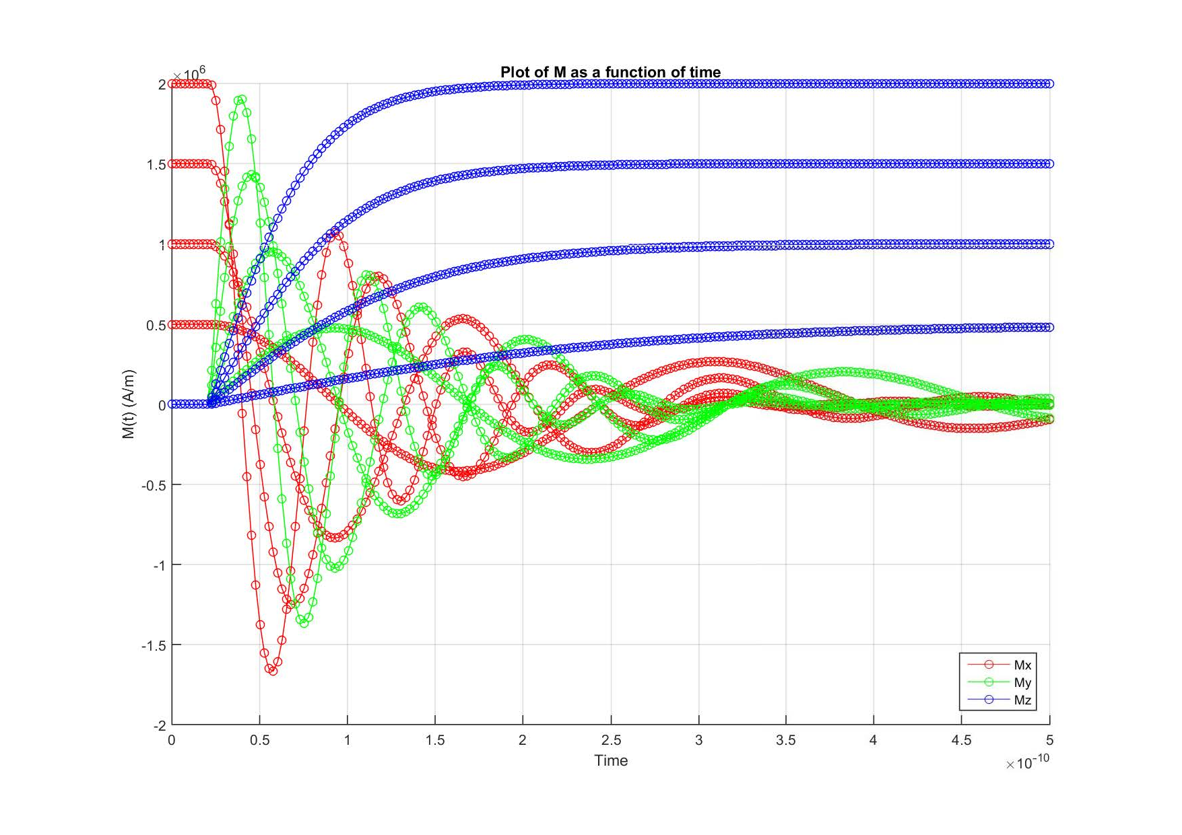
Model description
Macrospin: a single element is described by a single 3-D moment
Dynamic: each moment obeys the Landau Lifshitz equation
Starting condition: M(t=0) has to be specified
dM/dt is integrated for a stated time
z
M
Mz
My
y
Mx
x
4 elements, different Ms. Step function applied field in the z-direction at t=0.025ns

Slide 3
Features
Includes:
crystalline anisotropy;
shape anisotropy;
magnetostatic interactions between all elements, optional periodic BCs;
vertical exchange interactions between touching pairs (up-column only);
external vector applied field H(t)
Any number of elements (limited by CPU time, a 200 element loop takes about 3 minutes, but setup can take much longer (30+ minutes).
Most properties of each element can be different to the rest.
Elements have ellipsoidal cross-section in the x-y plane (can be circular)
Element shape is invariant in the z-direction.

Slide 4
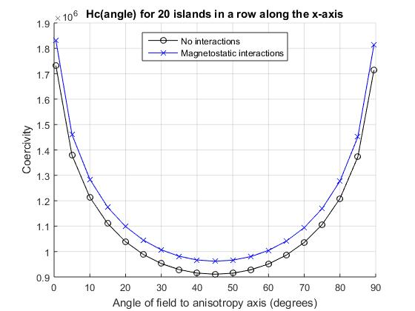
It seems to work…
The framework is flexible and self-documented but so far I haven’t contructed a user manual or GUI. Making it trivial to exploit the full flexibility is a non-trivial problem.

Slide 5
Example parameter setup
%---------------------------------------------------------------------
% S4 Inter-layer exchange parameters
%---------------------------------------------------------------------
% Hexg=M*Cexg*M;
% For surface to surface separation d then:
% Cexg={C0+C1*exp(-d/D1)+C2*exp(-2*d/D2)} * cos{(2*pi*d/lambda)+phi}
% C0, C1 and C2 are all per unit area.
LLG_ex_up=true;
exg_terms=[true,false,false,false]; % include the following terms:
exg_exp_0=0.1/(pi*a_mean*b_mean); % (/m^2) C0 in Hexg=C0*M
exg_exp_1=[0.0,0.1e-9]; % [/m^2,m]: [C1,D1] in Hexg=C1*exp(-d/D1)*M
exg_exp_2=[0.0,0.1e-9]; % [/m^2,m]: [C2,D2] in Hexg=C2*exp(-2*d/D2)*M
exg_cos=[1.0e-9,0.0]; % [m,radians]: [lambda,phi] in cos{(2*pi*d/lambda)+phi}

